Slide 1
Alps analysis
Embedding Alps into your culture
An Alps Champions Resource
2019/20

Slide 2
﻿Embedding Alps into your culture
The purpose of the session
Provide an overview of the Alps philosophy and culture
Describe how Alps analysis and Connect Interactive might fit into your Quality Assurance Cycle
Describe how you might get the most from your in-year monitoring in Connect Interactive
Additional information
Alps Cycle download from here
Monitoring checklist
Staff checklists from Knowledge Base

Slide 3
The Alps Mission
To support schools and colleges in raising student achievement and thus improve the life chances of young people.

Slide 4
The Quality Assurance model

Slide 5
Ensuring consistency across all staff
Most successful schools and colleges will have a clearly defined QA model that is understood by all staff.
There are many aspects to this, but in terms of embedding Alps, some of the points made across the next few slides should be considered when reviewing your QA cycle.

Slide 6
1. A clear and published assessment calendar
Staff are clear as to what assessment data will be expected from them and at which points in the academic year.
There is a shared understanding across all staff on the purpose of this analysis and the ways in which it will be used.
There is consistency across all staff about how to arrive at this grade.

Slide 7
Your Quality Assurance cycle
Publish a clear assessment calendar
One suggested model
Publish a clear definition of the ‘monitoring grade’ – see later slides
*MPZ – Monitoring Point Zero – see later slides
Year 12 | Year 13
Distribution of MEGs | MPZ* (1 Sept) A level & BTEC
Oct/Nov data input | Oct data input
Jan data input | Mocks + Jan predicted grades input
March/April data input | March data input
AS Exams/BTEC EoY summary

Slide 8
2. A clear target setting policy
Staff understand how Minimum Expected Grades (MEGs) are generated from national dataset.
Staff can use the MEGs to generate personalised target grades at a subject level, ensuring that these are aspirational and realistic for their students.
Staff plan to use MEGs and personalised target grades to track and monitor student progress across the course and are pro-active in involving students in this process.
Alps MEGs are a starting point.
Personalise MEGs by raising expectations for students with a flair for your subject.
Expect all teachers to have a ‘growth mindset’.

Slide 9
3. Clear expectations on the nature and purpose of monitoring grades
Do all staff know how and when they are expected to generate grades? Decide on grades to be submitted and share the purpose of each gradepoint with staff to ensure consistency.
Senior Leaders routinely meet with Subject Leaders to monitor progress towards target grades after each Connect Interactive data entry point.
Intervention strategies are devised carefully following each data entry point. Impact on progress is monitored closely and fed back into the QA process.
Staff know how to get the most from the monitoring accuracy area of Connect Interactive, so that they can make judgements on the consistency of teacher assessment.

Slide 10
4. Clear review period on QA cycle
Senior Leaders reflect on the success of the QA cycle for the Academic Year.
All staff involved in the review process.
Assessment calendar and QA cycle developed for coming Academic Year.

Slide 11
5. Clear process for Subject Review
Often the review and analysis of external examinations will feed directly into the line management/quality assurance model.
A shared understanding of the types of analysis to be carried out will lead to a more detailed and productive discussion between a senior leader and a subject lead, or between teachers within a subject area.
Many schools will ensure that subject areas have developed action plans in the Summer Term, and therefore this review of results should be a reflection on whether the priorities remain the same.

Slide 12
Alps and the QA Cycle
Alps cycle – this provides an overview of the aspects of QA that will be taking place in a school across the Academic Year, and the ways in which Alps analysis can support you.
Download Alps Cycle HERE
Staff checklists - these outline many of the questions that staff should be asking themselves during a review of examination results. Monitoring analysis and target setting. There are 4 staff checklists covering different roles within the school/college that have been designed to cover the analysis usually expected to be linked to that role. These can be found on the Knowledge Base or via the following links:
Senior Leader’s Checklist
Subject Leader's Checklist
Subject Teacher’s Checklist
Pastoral Leader’s Checklist

Slide 14
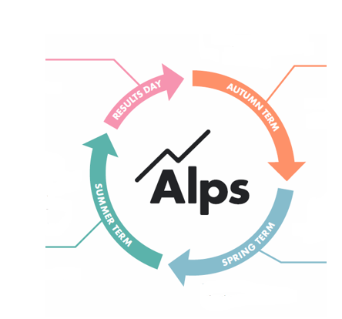
Quality assurance cycle – a summary
How will you set targets?
Do you have some start point data for Y13?
How will you determine your gradepoint data?
What are your priorities from the summer exams?
Any surprises?
Analysis of outcomes
Intervention
AND
impact
Your final monitoring point – how have you arrived at the final predictions?
What will your Alps grades look like?
Final intervention
How will you determine your gradepoint data?
Do you have mock results to analyse?

Slide 15
Training your staff and students

Slide 16
Preparing for your Training days
WORDS
Use the Digital Starter pack to prepare all staff for Alps analysis following the submission of examination results.
Ensure that your data team have given all staff access to Connect Interactive.
Use PowerPoint resource: Methodology and target setting
Use webinar: Getting started with Connect Interactive

Slide 17
Embedding Alps with staff
All teaching and associate staff involved in monitoring student progress and analysing examination results must have a good understanding of Alps.
Training sessions and focus groups need to be created within school meeting structure.
The precise training will depend on the role and expertise of those involved.
Clear on how to construct formal examination papers / milestone pieces of work.
Clear on marking criteria.
Quality feedback to students.

Slide 18
Embedding - students
Assemblies led by senior leaders to engage students in the process
Reinforced by teachers and tutors
Source of target grades clearly explained
Targets used formatively throughout the programme as two way dialogue between staff and students
Effective reporting of progress to students and parents
Student tracking summary sheets for the front of the student files with the MEG and personalised target at the top
Defined examination periods / formal assessments / milestone pieces of work – students clear on how these will be used by staff
Feedback focused on how to improve
Students involved in monitoring their progress against the target

Slide 19
Key Assembly/Presentation
Set the vision and standards positively.
Use an ‘assembly’ to introduce target setting and the expectation that all will reach minimum targets/MEG based on their performance at GCSE.
The MEGs are not predictions or a ceiling to their achievement .
Introduce how personalised targets are set as a two dialogue with staff.
Students are clear on how staff will use interim grades to intervene, support and challenge them to maximise their outcomes.

Slide 20
Getting the most from your examination analysis and subject review

Slide 21
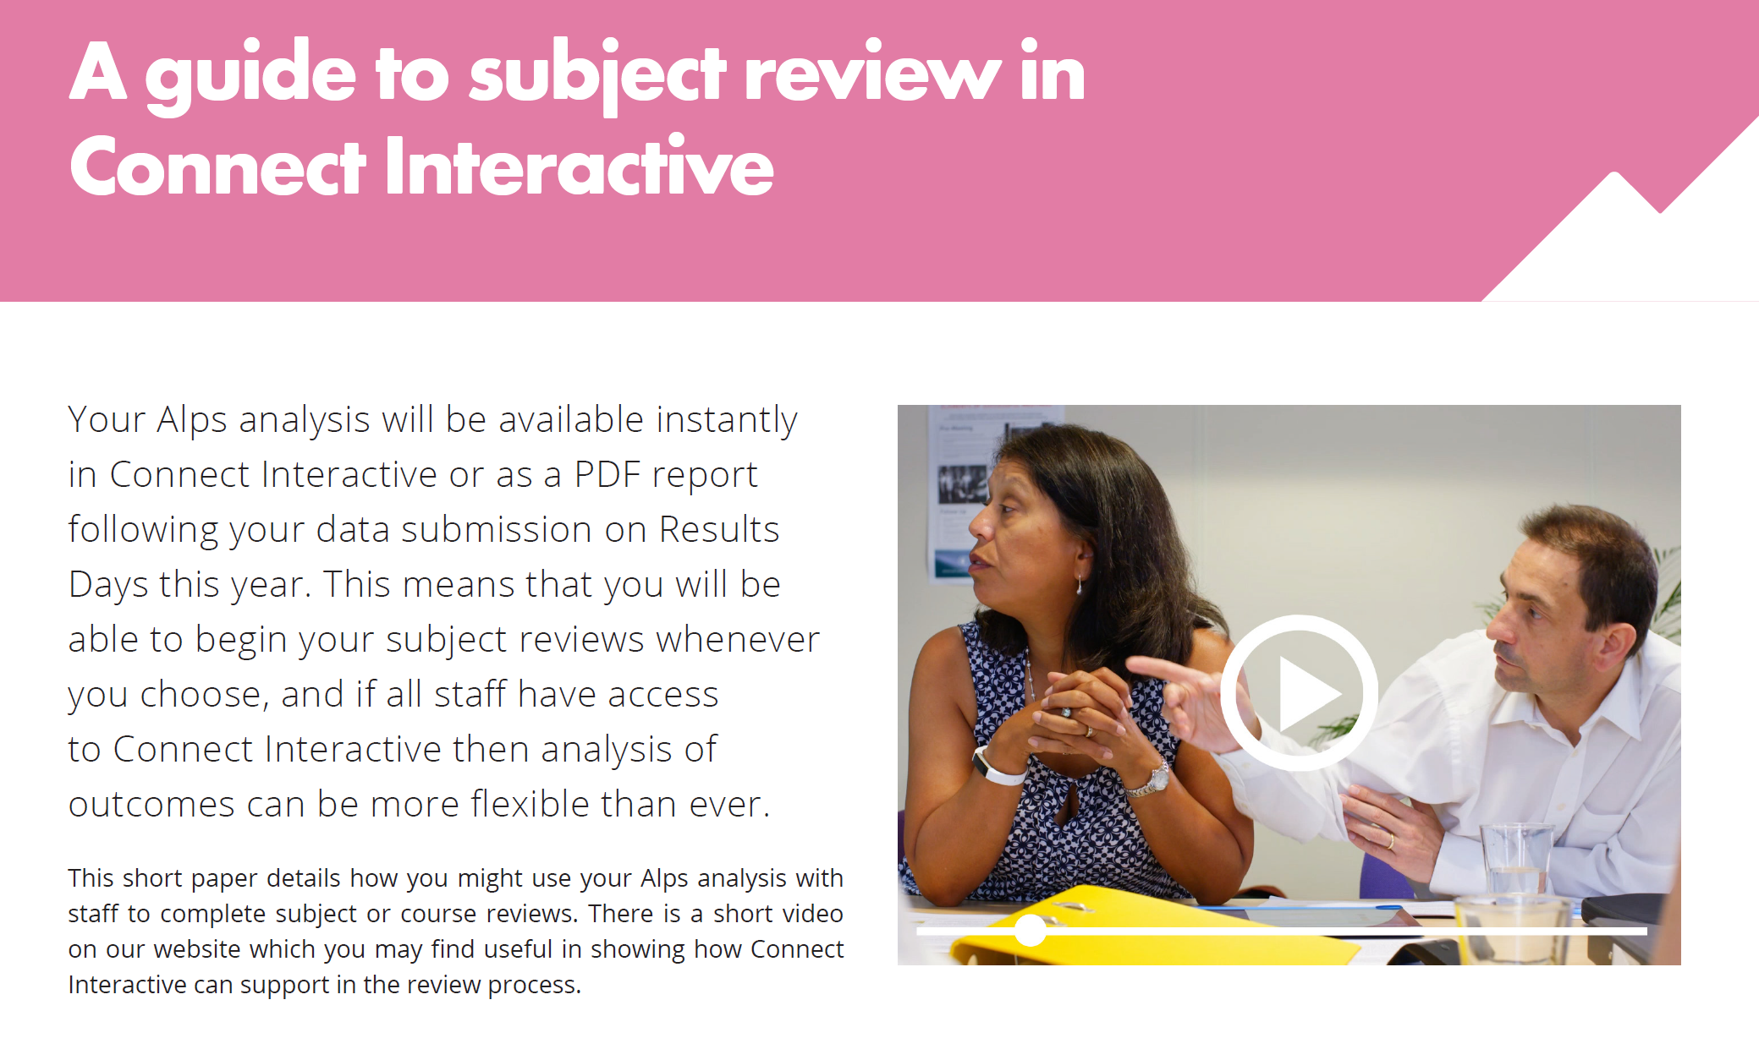
Connect Interactive quickly facilitates you in identifying questions to ask of your analysis:
Ensure that all staff have access to their analysis so that they can prepare thoroughly for their line management meeting focused on examination outcomes.
Use the staff checklists – subject review section as a prompt to addressing all areas of your analysis .
The Subject Review Checklist provides Senior Leaders with a more in depth overview of data analysis considerations.
For more of a discursive approach to Subject Review read the Briefing paper: A guide to subject review in Connect Interactive (PDF)

Slide 22
Using your Alps analysis effectively
Make sure you use your 2019 Alps analysis strategically with subject leaders.
Organise robust Performance Management meetings with all post-16 Heads of Department that focus both on evaluating 2019 performance and on planning to make a difference in 2019/20.
Be clear about what analysis are you expecting them to bring to the meeting?
Annotated Alps subject pages/Connect Interactive saved modelling.
If a department is significantly under-achieving, make it clear ‘what got you here won’t get you there’, agree what is going to be different and when you will be regularly checking up.

Slide 23
Using your Alps analysis effectively
Unless this is your first year with Alps and you have not submitted data for previous years, compare how you did in 2019 with 2018 and your 4 year trend;
Consider your School Improvement Plan for 2018-19. How well did you do in terms of priorities established early in academic year 2018-19?
Did any subject(s) under-perform so badly in 2019 that they need to be identified as a priority for improvement in 2019-20?
If there were several teaching sets in that subject was the under-performance consistent across the sets or are there certain areas that might be useful in the drive to improve performance in 2020?

Slide 24
Using your Alps analysis effectively
In Connect Interactive expect all Teaching staff to access Connect Interactive and perform some ‘What If’ and ‘How do I’ modelling analysis based on their end of year grades.
Expect them to identify student groups or students who made the difference to their teaching set value-added indicator.
Use our Connect Interactive Workbook for subject leads and classroom teachers.

Slide 25
Was your student monitoring effective?
The Monitoring Accuracy area of Connect Interactive will become more powerful as you add data across the Academic Year. It will enable you to ask questions of your staff in how well they predicted the actual student examination outcomes.
Compare your 2019 final predicted BTEC, AS and A Level grades to see which subjects and teachers predicted outcomes most and least accurately.
This will inform your monitoring, support and intervention in 2019-20.
The accuracy of predicted grades is crucial if you are to target support & intervention effectively.

Slide 26
September check list - Strategy
Does the Sixth Form have development priority in your current School Improvement Plan based on your analysis of 2019 outcomes and Alps?
Have post-16 improvement targets been set and published?
Have specific subjects and/or student groups been identified as priorities in the Sixth Form?
Who is responsible for checking on your identified priorities and when?

Slide 27
Monitoring and planning your data cycle
What grades will you be asked for and how will you ensure these are going to give you the best progress snapshot?

Slide 28
Embedding effective monitoring

Slide 29
What monitoring data will you use?
Connect Interactive allows you to enter an unlimited number of monitoring grades – not just an end of year product.
Ideally you will enter the grades which will help you to make the biggest impact on student progress
Year 12 into 13 – AS Grades/mock examination grades.
Teacher predicted grades – assess what your Alps analysis will look like on Results Day 2020.
Raw examination grades - outcomes from internal mocks or external AS grades – assesses gaps in demonstrated examination progress and targets.
Current working grades – where students are at any particular point in time again assessing gaps in demonstrated progress and targets. This is particularly relevant for BTEC courses.

Slide 30
Getting the most from data early in September – the MPZ
Monitoring Point Zero (MPZ) – the data you will use at the beginning of the Academic Year to define what your Alps gradings will look like on Results Day if all remains the same.
Year 13 – AS grades – remember to remove all students who have left or dropped subjects.
If you have no AS Grades then apply similar principles using Year 12 mock examination data.
Staff base all intervention on issues arising from this gradepoint.

Slide 31
What Year 13 data will you use?
BTEC
A Level
Use your BTEC course tracker to estimate most-likely end of Y13 final grades based units completed to date.
Make sure all students know what they need to accrue in Y13 units to gain higher overall grades.
Connect Interactive will show you what the overall & subject VA will be if the same results are achieved at the end of the BTEC course.
The AS Grades of students returning to take A Levels in 2020 (discounting any subject dropped by each student).
Use the 40% UMS achieved at AS to show students what is required to raise each grade.
Connect Interactive will show you what the overall & subject VA will be if the same grades are achieved at A Level.

Slide 32
Effective monitoring in Connect Interactive
Identify those making excellent progress – make them feel good about themselves.
Identify those making less progress than expected – are they having a significant effect on the overall subject and school indicators?
Devise intervention strategies to support students with immediate effect.
Use Monitoring Accuracy area - have there been predicting issues in any subject area in the past? Remember accurate predictions bring about well-focused interventions.

Slide 33
How can we use a monitoring gradepoint to impact on teaching and learning?
Your subject/teaching set grading? Red/almost red? How many students will it take?
Any gaps between key groups – gender? Or ability?
Any key grade boundaries you can focus on?
Are students doing better in other subjects than in yours?
If your grade is a current working at grade/raw examination grade – how far out is it? What does the ‘What If’ tell you about how many grades you will need to move before you get to submission date?
How will you use this information as you approach the next units/previous units to ensure students are hitting those grade criteria?
Is examination technique taught within lessons?
Are the grades you are entering accurate over time – monitoring accuracy?

Slide 34
Monitoring grades – are they quality assured?
Are grades recorded without first being quality assured by the head of subject or without discussion if the group is shared between teachers?
What evidence is used to validate the accuracy of monitoring grades?
Can you use an element of external assessment in each assignment, that has a mark scheme and examiners report to refer to?
Discussion at a department meeting to moderate the grades given by different teachers using the external element as the focus point.
As experience is gained then fewer of these exercises need to happen.
The accuracy of forecast/predicted grades will improve.

Slide 35
Predicted grades
In-year monitoring and tracking is critical and must be based on a common understanding of what a predicted grade means.
Our view is that a predicted grade should be a true reflection of what a student is most likely to achieve at the end of the course, based on all the evidence available up to that point in time – a professional prediction: the Most Likely grade.
Where underachievement is evident appropriate intervention must be put in place.

Slide 36
Mock examinations
How have these been constructed - were they based on exam material with external validation?
Have you examined material that has not been taught?
Did you expect much from Christmas revision? Is the timing right in the year?
Were you so focused on content that skills were not taught e.g. command words?
Have you set the right culture across the school/college that instils the importance of the mocks and how they will be used?
Was the distribution of material good enough, e.g. was the percentage of Assessment Objectives the same as is as set out in specification? Did your papers have the right distribution of different types of questions?

Slide 37
Consequences of inaccurate student predicted grades
Incorrect students are identified for intervention.
Students apply for inappropriate university courses.
School/college resources are targeted in the wrong curriculum areas.
Outcomes in the Summer come as a surprise.

Slide 38
‘Restless’ providers
Great providers are ‘restless providers’ where everyone believes they can learn new skills and improve.
Establish a culture of continuous incremental improvement every day by everyone, students, teachers and support staff.

Slide 39
Embedding Alps

