Slide 1
Getting started with Alps
Methodology and target setting – Wales / NI
An Alps Champions Resource
Notes:
Welcome to the Alps PowerPoint resource for you to use with staff. This PowerPoint is designed to support you in training your staff on Alps methodology and on target setting.

Slide 2
﻿Getting started with Alps
The purpose of the session
Provide an overview of the methodology and grading used throughout Alps Reports and in Connect
Explanation of the Alps Minimum Expected Grades at the 75th percentile.
Discuss how subject staff set Personalised Targets
Notes:
This presentation is specifically designed to support staff in their understanding of how the methodology works. It represents the main features of the methodology and is not a comprehensive overview. This can be found in the Alps Guide accessible to all staff via the Connect Homepage.
Here we will deal with how Alps generate the benchmarks – in other words where the numbers come from. This will lead to a definition and an understanding of the concept of Minimum Expected Grades or MEGs which form the basis for all calculations.
MEGs are only the starting point, and so following the MEG overview, we will look at how subject teachers can use the MEG and the subject thermometers to discuss appropriate and aspirational subject specific targets, or Personalised Targets with each student in their class.

Slide 3
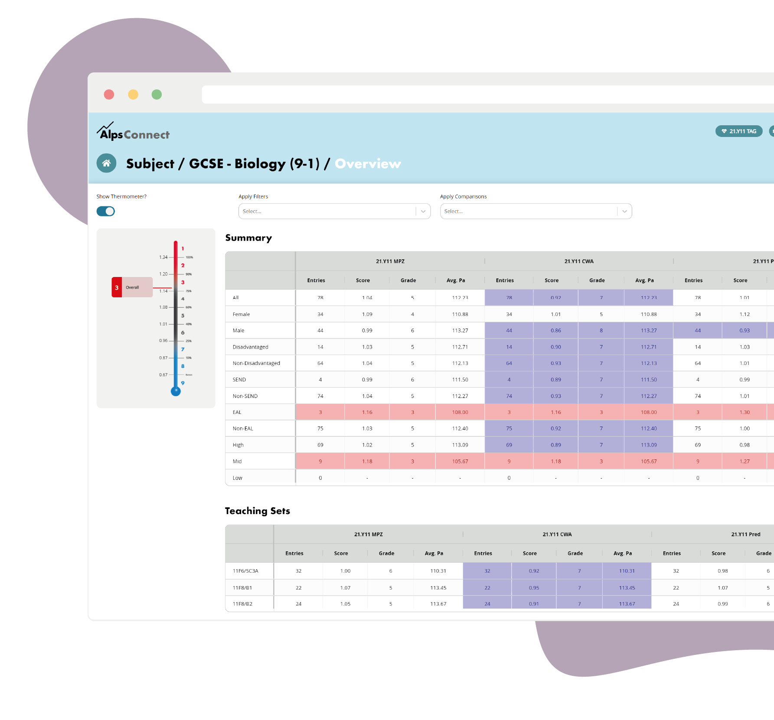
What is Alps?
Connect is an online tool accessible to all staff
Allows us to track progress and attainment of our students across the Academic Year
Allows us to set up our own groups of students that we want to track
Notes:
An introductory slide setting out what Alps is. The Alps system is based on a value-added progress model, but this does not preclude discussions with staff and students about attainment outcomes. Alps can be used at a subject and student level to facilitate conversations around student aspirations to attend top global universities.
Important points to emphasise – check all staff will have access to Connect. Ensure timelines for giving access are in place with your data administrator.

Slide 4
Alps analysis works on three levels
Strategic indicators – analysis at a whole school level
Subject indicators – analysis of subject and teaching sets
Student indicators – analysis at an individual student level against their Minimum Expected Grades
Notes:
The indicators that we are referring to give a picture of progress across the school. These centre on the 3 areas as set out on the slide.
At a whole school level, you will have various indicators which together provide a picture of how the schools is performing overall.
At a subject level, each subject and teaching set (optional) is given an Alps grade and colour indicating how they are performing relative to other departments in the same subject in the national dataset.
The student level analysis provides an overview of how each individual student is performing relative to their aspirational expected grade. Teachers can see how their students are performing in their other examination entries.

Slide 5
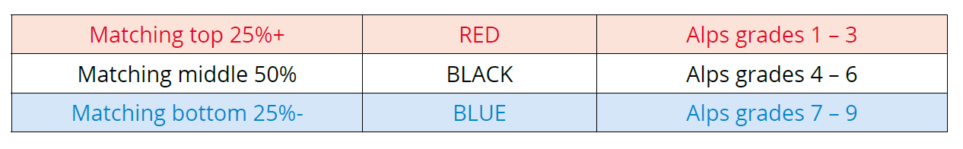
The Alps Grading system
All Alps indicators follow a common grading pattern
These grades then translate onto a unique thermometer for each indicator
RED is HOT, BLUE is NOT
Notes:
To start to understand Alps, first we have to recognise that throughout the Alps analysis, be it in Connect Interactive or a PDF Report, there are Alps grades. These are consistent across all indicators in the analysis and follow a colour and grading pattern. Each indicator in your analysis will therefore have an Alps grade and colour.
The slides on grading apply both to Key Stage 4 and to Key Stage 5.
The Alps colours are RED BLACK and BLUE which give a simple, visual indication of where your progress is aligned against the 1-9 Alps scale.
Progress grades of 1-3 are the highest grades and are RED HOT, in other words, your progress for that indicator is equivalent to the provider or department in the top 25%.
Conversely, grades 7-9 are BLUE and indicate progress in the lowest 25%.
Black grades of 4-6 are broadly in line with the national average.
In terms of setting priorities, your blue indicators should be top of the list, whilst red indicators mark out areas of strong practice.

Slide 6
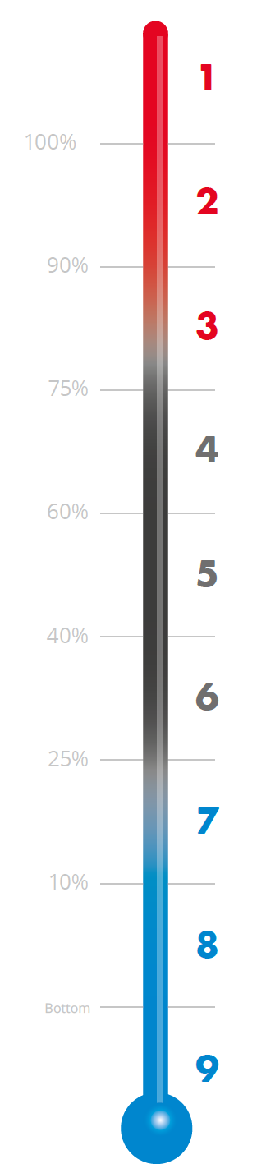
The Alps Thermometer
Grades 1-3 mean you have matched the providers in the top 25% for that indicator
Your indicators are RED
Grades 4-6 mean your progress is broadly in line with the national average and indicators are
BLACK
Grades 7-9 means progress is in the lowest 25% nationally
These indicators are BLUE
Notes:
The RED BLACK and BLUE colours come from the Alps thermometer, with RED HOT at the top. The thermometer is where the simplicity of the Alps system lies.
All indicators in the analysis have a unique thermometer which plots the progress against the national dataset. The thermometer shown here shows how each grade corresponds to the progress made by other providers. For example, an Alps grade of 2 plots you in the top 10% for any indicator in your analysis. An Alps grade of 1 means that the progress you have achieved matches the top provider in the dataset.

Slide 7
Unique thermometers
Every thermometer in your Alps analysis has a unique scale
They have been constructed independently based on progress for that indicator nationally
Familiarity with the scales is important, particularly at a subject level – we will return to this in the Personalised Target section
Notes:
All Indicators across the analysis have a thermometer, but the scale in each one is unique.
Subject scales have been generated independently – when you look at your subject thermometer, the progress you have made is plotted against progress made nationally in that subject only.
If you are to set meaningful and aspirational targets with students, then we must as subject staff understand the unique nature of our thermometers and how this relates to progress nationally in our subject. Only then can we ensure that the dialogue we have with our students is fully informed and that we are giving them the best opportunity to attain grades which will open doors.

Slide 8
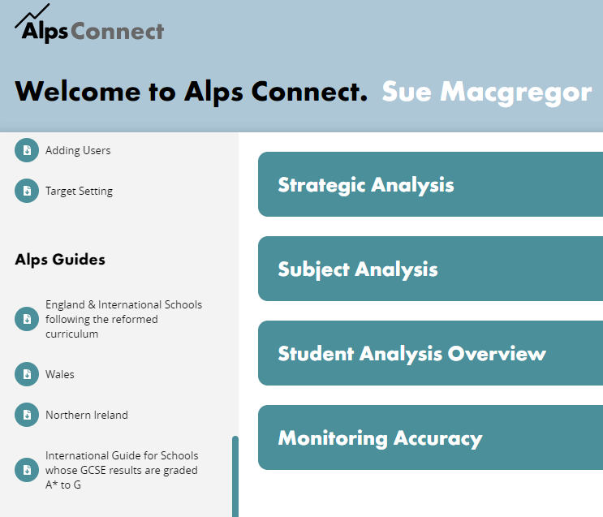
The Alps Methodology
The next few slides will:
Provide overview of how the numbers are generated
Explain the MEGs
Describe how progress is measured across A level and BTEC courses and at Key Stage 4
Notes:
Before looking at the subject thermometers, we must understand the concept of the Minimum Expected Grade. All of the calculations and grading made in the Alps analysis is based on these scores.
Although the measurement of progress various across the different types of qualifications, the methodology is the same for all post-16 courses and at Key Stage 4.
The numbers and Minimum Expected Grades, or MEGs, are explained fully in the Alps Guides. In the Guide, Alps publish all of the benchmark tables, which give a full and transparent overview of where the numbers come from.
Logging in to Connect takes you to the Connect Homepage. If you wish to know more than we cover here on methodology, you will find the Guide in the Resources section.

Slide 9



How progress is measured
A/AS Level
BTEC – Level 3
Key Stage 4
Prior attainment
Average GCSE Score
Alps output remains as
‘old’ UCAS points
Prior attainment
Average GCSE Score
Alps output remains as
‘old’ UCAS points
Prior attainment
Y8 Welsh National Tests
GCSE points
Notes:
The Alps analysis is based on progress. The starting point for all post-16 courses is the GCSE prior attainment score – that is the average GCSE score attained by a student across all GCSE/iGCSE entries.
The output for A/AS and BTEC courses are the UCAS point.
Alps analysis measure the value that we add between start point and end point and compares this to the value-added from all providers nationally.

Slide 10

How progress is measured – KS4
Key Stage 4
Year 10 and 11
  The WNT scores are aligned to English KS2 bands at this stage.
Prior attainment
Y8 Welsh National Tests
  We have used students’ best English or Welsh score and their procedural mathematics to calculate the average.
GCSE points
Notes:
The starting point for all GCSE qualifications is the Welsh National Test score from Year 8 and is taken from the average of the best English/Welsh and procedural maths.
The output for Key Stage 4 are the GCSE points 0-8.
Alps analysis measure the value that we add between start point and end point and compares this to the value-added from all providers nationally.

Slide 11
Key Stage 5
A level
BTEC

Slide 12
A Level
1 | 7.5+
2 | 7.0-<7.5
3 | 6.7-<7.0
4 | 6.4-<6.7
5 | 6.1-<6.4
6 | 5.8-<6.1
7 | 5.5-<5.8
8 | 5.2-<5.5
9 | 4.7-<5.2
10 | 4.0-<4.7
11 | 0.0-<4.0
BTEC
1
2 | 6.4-<6.7
3 | 6.1-<6.4
4 | 5.8-<6.1
5 | 5.5-<5.8
6 | 5.2-<5.5
7 | 4.7<5.2
8 | 4.3-<4.7
9 | 4.0-<4.3
10 | 3.5-<4.0
Students are sorted into Alps Bands according to prior attainment
And 10 at BTEC – note these have a different distribution pattern
There are 11 A level bands
Notes:
KEY STAGE 5 SLIDES 12-16
To start to understand the generation of the MEGs, we first split the prior attainment into bands.
At A Level and AS level, there are 11 bands with the distribution scores as shown in the table.
The BTEC also has 11 prior attainment bands, but as you can see, the distribution is slightly different due to the ability range of the students opting for the vocational courses.

Slide 13
A Level
1 | 7.5+
2 | 7.0-<7.5
3 | 6.7-<7.0
4 | 6.4-<6.7
5 | 6.1-<6.4
6 | 5.8-<6.1
7 | 5.5-<5.8
8 | 5.2-<5.5
9 | 4.7-<5.2
10 | 4.0-<4.7
11 | 0.0-<4.0
87.56
92.00
106.00
66.49
83.33
92.00
106.00
66.49
83.33
0
25th
50th
75th
100th
B/C
The schools achieving progress outcomes in the 25% become red hot
Those in the lowest 25% have blue outcome points
Using prior attainment band 5 at GCSE, we can see that students make different amounts of progress in different schools
For each school in the national dataset, Alps measure how much progress they make with the students they had in each band
The schools are now ranked from highest points to lowest
The points scored by the provider at the 75% line become the Minimum Expected Points needed to be achieved ON AVERAGE by students in this category if you are to be RED HOT overall as a school.
This can be translated into an A level grade. This is known as the Minimum Expected Grade or MEG.
Notes:
This slide is going to take us through the methodology used to generate the MEGs at A level. The other qualifications follow a similar pattern.
Let’s look at band 5– that’s the category of students who have achieved between 6.10-6.40 at GCSE..
Of all of the providers in the national dataset who had students in this category, we need to know the range of average output points that were achieved. Those output points vary from 66.49 to 106.00. That is a big range and obviously affects the life chances of the students in that category.
Next we rank the scores – the provider who achieved 106.00 is the top provider and sits at 100%, at the top of the thermometer. The provider achieving 66.49 sits at the bottom of the thermometer. The rest of the scores are ranked accordingly.
The Alps philosophy is based on matching what the provider at the 75th percentile achieved. If we can match this on average with all of our students in this top band, then we would have made progress equivalent to the top 25% of schools in the dataset.
We translate this 75th percentile score of 92.00 into a grade – B/C. This becomes the Minimum Expected Grade – the MEG. It is the start point for our target setting with this band of students.

Slide 14
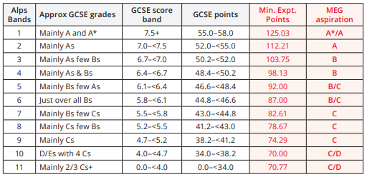
The MEGs
MEG – Minimum Expected Grade
In each prior attainment band the MEG is the average grade attained by the provider at the 75th percentile in the national dataset.
If every student achieved their MEG in all examinations, then the headline indicator, the Quality Indicator, for the school would be RED HOT and you would be a top 25% progress provider.
Notes:
If we carry out this exercise for all prior attainment bands, we generate our MEGs across the ability range. This is the MEG table for A level.
NOTE: the MEG is the minimum – it is not a ceiling for target setting.
If every one of our students got their MEG in all subjects, then we would be a RED HOT provider – top 25%.
The MEG is an average across all subjects. We need to understand how our subject progress relates to this MEG, so that we can guide our students appropriately and ensure that they are competitive in their grade aspirations as they apply for Universities, apprenticeship and jobs.

Slide 15
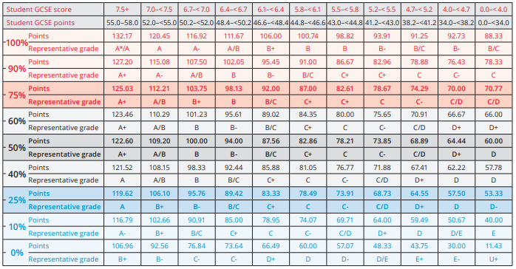
Benchmarks for 2021 A level Results
Notes:
This is the full benchmark table for your A level students. You will see that the prior attainment bands are in the top row. The dark red line indicates the MEGs at the 75% for all prior attainment bands.
Full details can be found in the Alps Guide (Wales) p9.

Slide 16
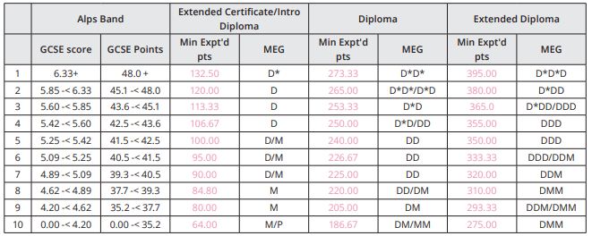
BTEC 2016 minimum expected grades
Notes:
MEGs for the 2016 BTEC suite

Slide 17
Key Stage 4

Slide 18
Y8 WNT
1 | 126+
2 | 116-<126
3 | 108-<116
4 | 102.5-<108
5 | 94-<102.5
6 | 89-<94
7 | 86-<89
8 | 82-<86
9 | 78-<82
10 | 0-<78
Students are sorted into Alps Bands according to prior attainment
There are 10 GCSE bands from Year 8 Welsh National Test Scores
Notes:
KEY STAGE 4 SLIDE 17 - 21
To start to understand the generation of the MEGs, we first split the prior attainment into bands.
At Key Stage 4, there are 10 bands with the distribution scores as shown in the table.
Vocational Level 2 banding follows the same pattern as GCSE.

Slide 19
Output points
3.33/30
4.42/37
4.69/38
4.95/40
5.67/44
3.33/30
4.42/37
4.95/40
5.67/44
Y8 WNT
1 | 126+
2 | 116-<126
3 | 108-<116
4 | 102.5-<108
5 | 94-<102.5
6 | 89-<94
7 | 86-<89
8 | 82-<86
9 | 78-<82
10 | 0-<78
0
25th
50th
75th
100th
C
Using prior attainment band 3 at GCSE, we can see that students make different amounts of progress in different schools
The points scored by the provider at the 75% line become the Minimum Expected Points needed to be achieved ON AVERAGE by students in this category if you are to be RED HOT overall as a school.
This can be translated into a GCSE grade. This is known as the Minimum Expected Grade or MEG.
The schools achieving progress outcomes in the 25% become red hot
Those in the lowest 25% have blue outcome points
The schools are now ranked from highest points to lowest
For each school in the national dataset, Alps measure how much progress they make with the students they had in each band
Notes:
This slide is going to take us through the methodology used to generate the MEGs at GCSE. To start to understand the generation of the MEGs, we first split the prior attainment into bands.
At GCSE, there are 10 bands with the distribution scores as shown in the table.
Let’s look at the band where there are a large number of students – that’s the category of students who have achieved 94-102.5 in their WNT.
Of all of the providers in the national dataset who had students in this category, we need to know the range of average output points that were achieved. Those output points vary from 3.33 to 5.67 or 30-44 in QCA points. That is a big range and obviously affects the life chances of the students in that category.
Next we rank the scores – the provider who achieved 5.67 is the top provider and sits at 100%, at the top of the thermometer. The provider achieving 3.33/30 sits at the bottom of the thermometer. The rest of the scores are ranked accordingly.
The Alps philosophy is based on matching what the provider at the 75th percentile achieved. If we can match this on average with all of our students in this top band, then we would have made progress equivalent to the top 25% of schools in the dataset.
We translate this 75th percentile score of 4.95/40 into a grade – C. This becomes the Minimum Expected Grade – the MEG. It is the start point for our target setting with this band of students.

Slide 20
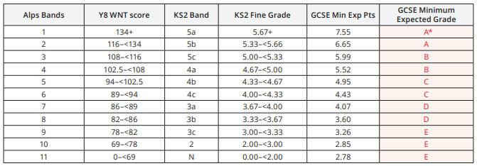
The MEGs
MEG – Minimum Expected Grade
In each prior attainment band the MEG is the average grade attained by the provider at the 75th percentile in the national dataset.
If every student achieved their MEG in all examinations, then the headline indicator, the Quality Indicator, for the school would be RED HOT and you would be a top 25% progress provider.
Notes:
If we carry out this exercise for all prior attainment bands, we generate our MEGs across the ability range. This is the MEG table for GCSE.
NOTE: the MEG is the minimum – it is not a ceiling for target setting.
If every one of our students got their MEG in all subjects, then we would be a RED HOT provider – top 25%.
The MEG is an average across all subjects. We need to understand how our subject progress relates to this MEG, so that we can guide our students appropriately and ensure that they are competitive in their grade aspirations as they apply for their post-16 options.

Slide 21
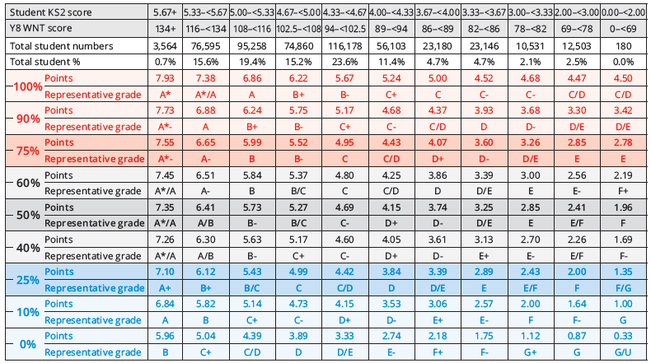
Benchmarks for 2021 KS4 Results
Notes:
This is the full benchmark table for your GCSE students. You will see that the prior attainment bands are in the top row. The dark red line indicates the MEGs at the 75% for all prior attainment bands.
Full details can be found in the Alps Guide (Wales) p63.

Slide 22
Using the MEGs at a subject level
– setting Personalised Targets
How does progress in your subject compare to that MEG?
How will you set a subject specific target which is aspirational enough to get you a red Alps grade?
Notes:
We are now going to look at the uniqueness of the subject thermometers and how they can be used to set Personalised Targets at a subject level. We will take MEGs and thermometer scales into account.

Slide 23
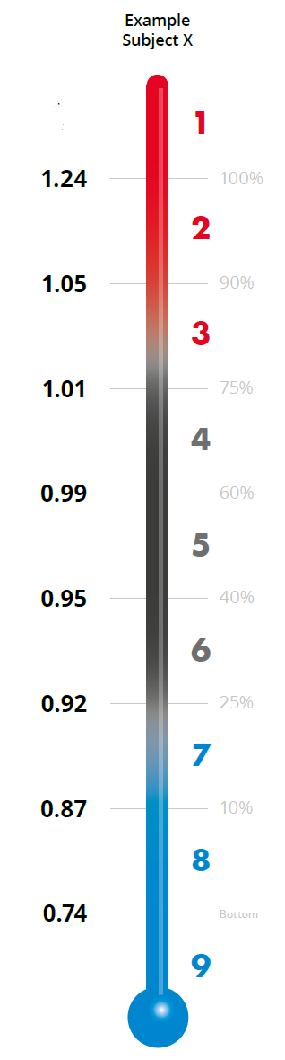

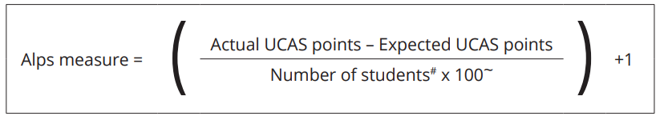
The unique subject thermometers
Top progress score achieved in this subject
Alps subject value-added scores are calculated using a formula which rotates around 1.00
If every student in your teaching group achieved their MEG, then you would achieve a value-added score of 1.00
Bottom progress score achieved
Notes:
Each subject in the dataset is analysed independently.
First, the Alps score is calculated using the formula. It means that each department gets an Alps score that rotates around 1.00. If all students in your class achieve their MEG, your Alps score will be 1.00.
Next, the thermometer is constructed for each subject using the Alps scores. In this example, the department at the top of the thermometer for this subject achieved 1.24 and the one at the bottom, 0.74. Quite a difference. In order for you to be a RED HOT department, you need to achieve 1.01 in this subject. In other words, each student has to get their MEG. This was what the department at the 75th percentile achieved.

Slide 24
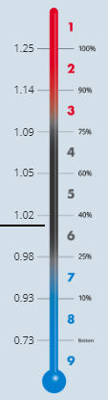
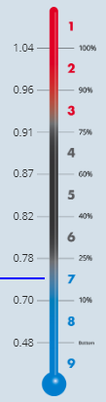
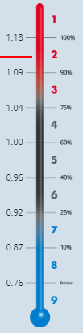
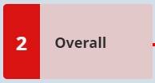

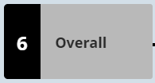
How MEGs relate to subject Alps grades
A – Media Studies
A – English Literature
A – Biology
Alps scores
If everyone in your teaching group achieved their MEG, then you would achieve an overall Alps score of 1.00
But each subject has its own unique thermometer as national progress varies across subjects
Notes:
KEY STAGE 5 SLIDES 23-27 DELETE AS APPROPRIATE
All subject thermometers are constructed independently using this methodology. They all look different as different subjects make different progress nationally. In other words, the top Alps score and the bottom Alps score is different according to subject.
Here are 3 examples – note some thermometers may vary.
In Media Studies, the top of the thermometer is 1.25. In Biology it is 1.04 and in English Literature it is 1.18. All very different. If we were to look at where an Alps score of 1.00 would get us (all students achieving the MEG) then we would have a Grade 6, Grade 2 and a Grade 4 respectively. This means that when we are setting subject specific targets, we need to be aware of 2 things
The MEG
The scale on our thermometers.

Slide 25
A note on numbers
There are a few important numbers in Alps
1.00 – the score achieved if everyone hits their MEGs
0.2 – the difference in the Alps score equivalent to 1 grade per student
In BTEC, 0.4 is a grade per entry.
1.25 = almost 0.3 above the 1.00 ‘MEG’ value equivalent to 1 and a half grades per student – to match the top media department
1.09 – is 0.1 above the ‘MEG’ value, therefore half of the students (0.1 is a half of 0.2) need to be above MEG to hit RED HOT
Notes:
So how do we interpret our thermometers?
We know that 1.00 is the Alps score that we achieve if all students hit their MEGs.
0.2 is equivalent to 1 grade per student, so if all students gained a grade higher than the MEG, we would have an overall Alps score of 1.20. If they all dropped a grade then we would score 0.80.
In Media then, a score of 1.00 gets us a grade 6. The RED HOT score is 1.09, rounded to 1.10 means that half of our students need to perform a grade higher than the MEG (with 0.1 being half of 0.2). In our personalised target setting we must take this into account in Media Studies, or we will do a disservice to our students. Nationally students are performing higher than the MEG in Media and so in order to compete for University places, we must match this aspiration when setting targets.

Slide 26
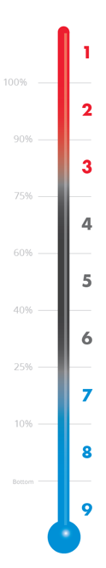
What does an Alps score of 1.00 mean for my subject?
At A Level
At BTEC
Biology
Mathematics
English Literature
Religious Studies
Media Studies
2016 Dip Applied Science
2016 Dip Business
2016 Ext Cert Art & Design
2016 Ext Cert Applied Law
An Alps score of 1.00 yields very different Alps grades dependent on subject
Students nationally make better progress in some subjects than in others
Notes:
A summary then of what the 1.00 scores in various A level and BTEC courses.

Slide 27
Setting personalised targets by subject MEGs as a starting point
You need to set your subject specific target to ensure you are being aspirational.
In biology, subject targets may be in line with the Alps MEG, whereas in media studies students may have subject targets that are one above the Alps MEG.
Finally, you should take other factors into account, i.e. if a student has a particular flair in your subject.
Notes:
Knowing the scale on your thermometer, and knowing that 0.2 represents a grade per entry, you can then start to make some decisions on how to set personalised targets. This should always be discussed with the students so that they understand how students in other schools and colleges are performing, and therefore what they need to do to maximise their chances of achieving those top university places.
Finally, this target setting is all generic, and you must always take into account other factors when setting them. In the more creative subjects for example, it may be pertinent to take flair into account when setting the personalised target.

Slide 28
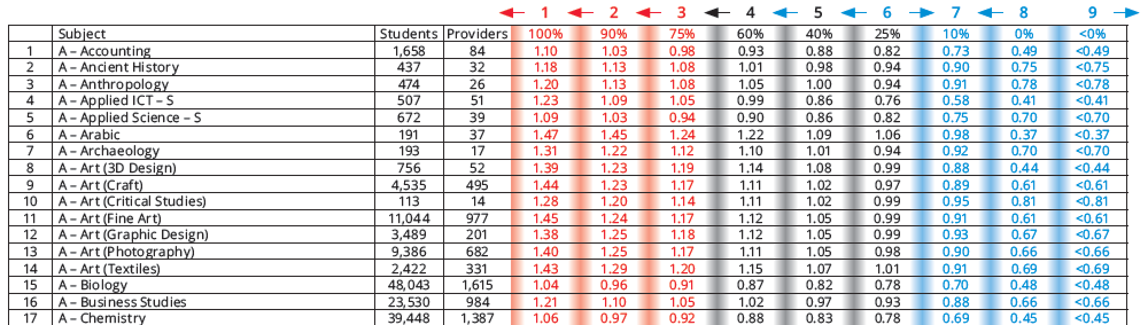
The Alps Guide
Subject thermometer pages
Notes:
All subject thermometers are in the Alps Guide p85

Slide 29
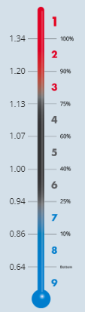
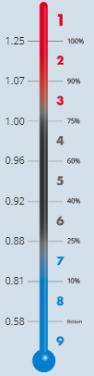
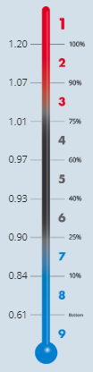

How MEGs relate to subject Alps grades
GCSE - Biology
GCSE - Mathematics
GCSE – English Language
Alps scores
If everyone in your teaching group achieved their MEG, then you would achieve an overall Alps score of 1.00
But each subject has its own unique thermometer as national progress varies across subjects
Notes:
KEY STAGE 4 SLIDES 28-32 DELETE AS APPROPRIATE
All subject thermometers are constructed independently using this methodology. They all look different as different subjects make different progress nationally. In other words, the top Alps score and the bottom Alps score is different according to subject.
Here are 3 examples – note some thermometers may vary.
In biology, the 75th percentile line on the thermometer is 1.13. In Maths it is 0.91 and in English Language it is 1.01. All very different. If we were to look at where an Alps score of 1.00 would get us (all students achieving the MEG) then we would have a Grade 6, Grade 3 and a Grade 4 respectively. This means that when we are setting subject specific targets, we need to be aware of 2 things
The MEG
The scale on our thermometers.

Slide 30
A note on numbers
There are a few important numbers in Alps
1.00 – the score achieved if everyone hits their MEGs
0.2 – the difference in the Alps score equivalent to 1 grade per student
In BTEC, 0.4 is a grade per entry.
1.34 = 0.3 above the 1.00 ‘MEG’ value equivalent to 1 and a half grades per student – to match the top biology department
1.13 – is roughly 0.15 above the ‘MEG’ value, therefore three quarters of the students (0.15 is three quarters of 0.2) need to be above MEG to hit RED HOT
Notes:
So how do we interpret our thermometers?
We know that 1.00 is the Alps score that we achieve if all students hit their MEGs.
0.2 is equivalent to 1 grade per student, so if all students gained a grade higher than the MEG, we would have an overall Alps score of 1.20. If they all dropped a grade then we would score 0.80.
In biology then, a score of 1.00 gets us a grade 6. The RED HOT score is 1.13, rounded to 1.15 means that three quarters of our students need to perform a grade higher than the MEG (with 0.15 being three quarters of 0.2). In our personalised target setting we must take this into account in biology, or we will do a disservice to our students. Nationally students are performing higher than the MEG in biology and so in order to match that progress, we must set our targets accordingly.

Slide 31
What does an Alps score of 1.00 mean for my subject?
At GCSE
At Vocational Level 2
Economics
Mathematics
English Language
Art & Design
Biology
BTEC First IT
BTEC First Business
BTEC First Performing Arts
Cam Nat Cert Sports Science
An Alps score of 1.00 yields very different Alps grades dependent on subject
Students nationally make better progress in some subjects than in others
Notes:
A summary then of what the 1.00 scores in various Key Stage 4 courses.

Slide 32
Setting personalised targets by subject MEGs as a starting point
You need to set your subject specific target to ensure you are being aspirational.
In mathematics, subject targets may be in line with the Alps MEG, whereas in biology students may have subject targets that are one above the Alps MEG.
Finally, you should take other factors into account, i.e. if a student has a particular flair in your subject.
Notes:
Knowing the scale on your thermometer, and knowing that 0.2 represents a grade per entry, you can then start to make some decisions on how to set personalised targets. This should always be discussed with the students so that they understand how students in other schools and colleges are performing, and therefore what they need to do to maximise their chances of achieving those top university places.
Finally, this target setting is all generic, and you must always take into account other factors when setting them. In the more creative subjects for example, it may be pertinent to take flair into account when setting the personalised target.

Slide 33
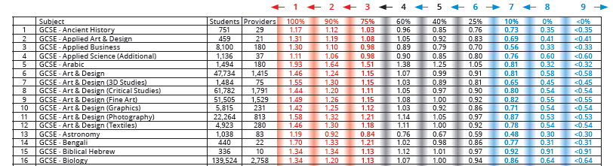
The Alps Guide
Subject thermometer pages
Notes:
All subject thermometers are in the Alps Guide

Slide 34
﻿Setting the ethos of aspiration
Teamwork
Top performing schools/colleges train students to understand how the target setting process supports them in being aspirational.
Get students to calculate their own MEGs, pointing out that these are minimum grades only.
Two way dialogue with the student on Personalised Target setting by subject - University aspirations would form part of this discussion.
Notes:
Finally
Involving the students in this target setting process is key. Target setting should be a two way dialogue between students and teacher. Targets should be reviewed alongside progress.

Slide 35
﻿Additional information
Available on the Alps Champions page accessible from the Connect Homepage
On-demand video which follows this PowerPoint on Target Setting
Resources such as short videos on how to get the most from Connect
Briefing papers on Target Setting - Using Alps to set aspirational targets with students
Knowledge Base
Staff checklists
These have a Target Setting section to tick off
Notes:
There are various other places where you can get additional information on the methodology and on target setting including webinars and briefing papers.
The Alps Champions page, accessible from the Connect Homepage has access to a variety of resources to guide you through Connect.
The Knowledge Base, accessible from the homepage or from within Connect, has many support articles, videos and guides.

Slide 36
Staff checklists
https://alps.zendesk.com/hc/en-us
Notes:
These are samples of the checklists available on the Knowledge Base. There are 4 checklists written to tie in with your role in the school –
Senior Leaders
Subject Leaders
Subject Teachers
Pastoral Leaders
These are broken down into 4 sections and provide a number of helpful questions to consider when you are analysing your data and setting priorities.

